Slide 1





VIODETECT
AI-Based Violent
Video Detection
Presented by:
2301040117 - Hoang Van Minh
2301040161 - Le Bao Quoc
2201040078 - Pham Phuong Hong
2201040006 - Nguyen Hoang Anh
2201040121 - Phung Thị Nga

Slide 2





Introduction
Safety Should Be Proactive
Human monitoring is imperfect, prone to fatigue, and can miss critical moments.
Promote safety in schools, hospitals, and public spaces,...

Slide 3




Model Training
1
Video Input
2
Extract
video frames
3
Feature extraction:
ResNet50
4
Understand motion:
TSM
5
Output:
Violence probability

Slide 4



Data Leakage & Solution
 | folder_name | label | total_num_npy_file | num_sub_folder
0 | 0_1 man escape | Violence | 78 | 1
1 | 0_A girl is muckbang | Unknown | 0 | 0
2 | 100_2 wm fight on crossing line | Violence | 207 | 2
3 | 101_2 wm fight outside a house, 1 fat wear ... | Violence | 177 | 1
4 | 102_2 wm fight slow motion | Violence | 522 | 3
Train Random Forest with metadata
F1 on val set = F1 on test set 0.93
Divide train, val, test into folders
Use greedy algorithm, sort from top to bottom by total_num_npy_file
Retrained TSM model achieved 0.87 F1-Score
Export trained model weights (*.pt file)

Slide 5
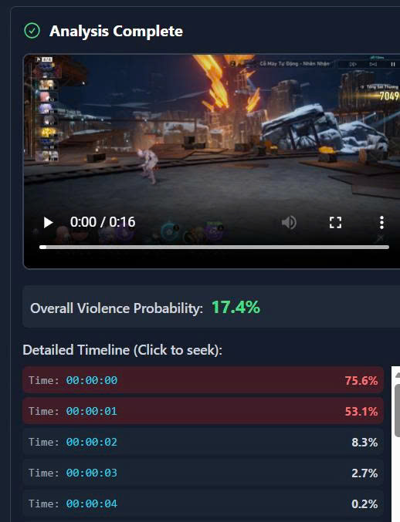
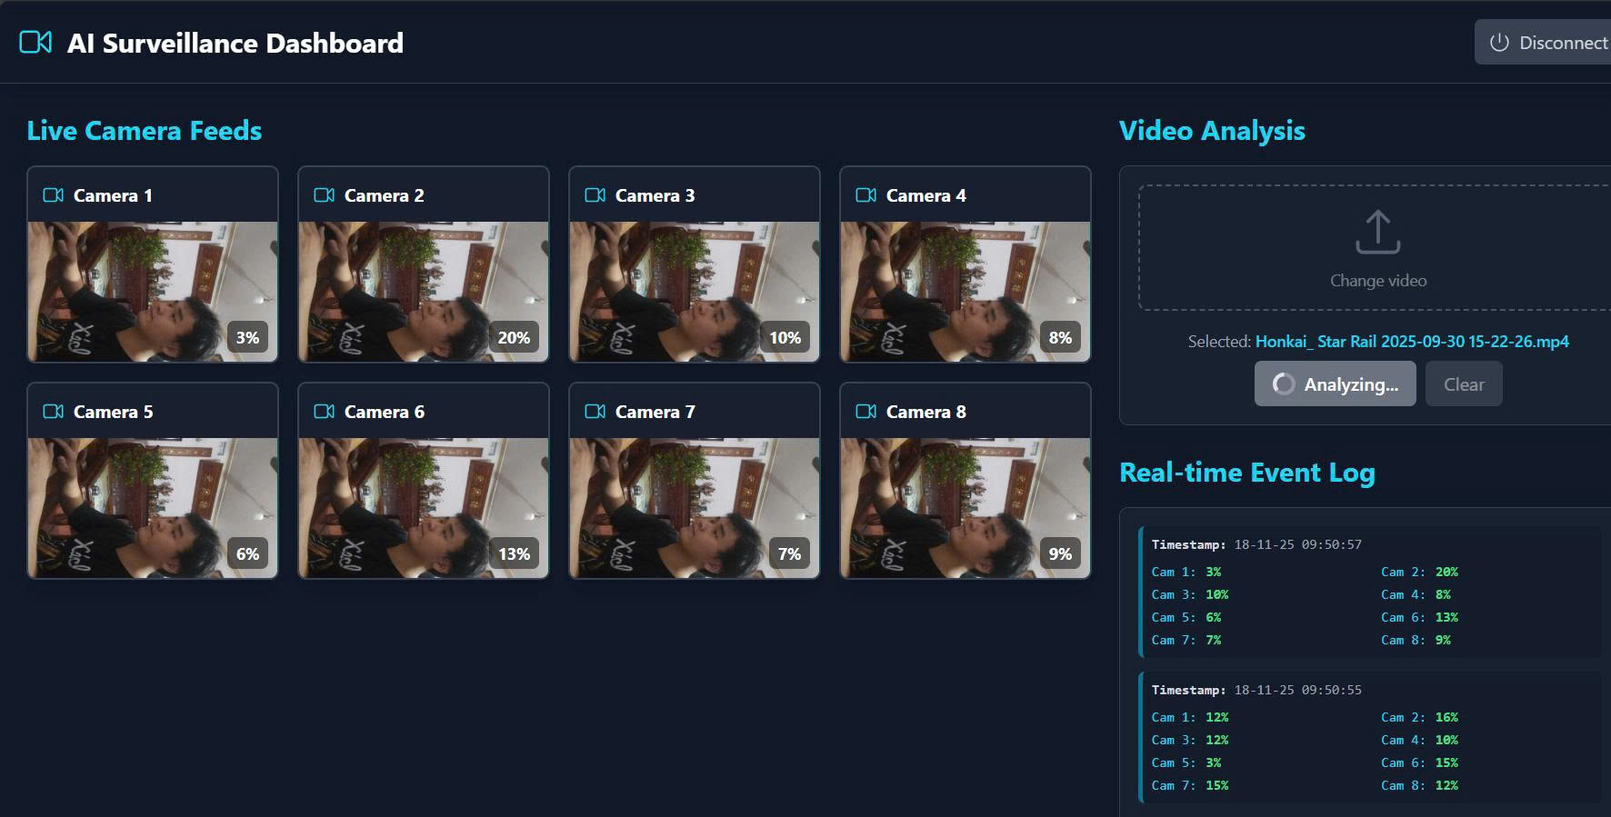
Software Devalopment
Frontend
Backend
Functions
JavaScript, TypeScript
Python, PyTorch, FFmpeg
Real-Time Monitoring (up to 8 cameras simultaneously)
Offline Analysis
React, Tailwind Css, Phosphor Icons

Slide 6


Technical Advancements
Batch Processing
Reduces time needed for real time prediction
Data Leakage Detection
Memory Control
Using DatasetLoader to prevent memory leak + RAM overloadded
Ensures model reliability and generalizability
Collaborative Distributed Training
Everyone shares time and device together

Slide 7


Limitation & Future Work
Occasional False Alarms (F1 ~0.87)
Enhance Model Accuracy with more diverse training data
Choppy alerts
(too brief)
Implement Sustained Alerting for entire violent events
Incomplete Blur Feature
Develop Automatic Blurring to protect viewer privacy

Slide 8


THANK YOU!

